Slide 1
How close is too close? The role of feature attributions in discovering counterfactual explanations

Slide 2
CONTEXT
AUTHORS
Anjana Wijekoon, Nirmalie Wiratunga, Ikechukwu Nkisi-Orji, Chamath Palihawadana, David Corsar, and Kyle Martin
School of Computing, Robert Gordon University in Scotland
MOTIVATION
Presenting the DisCERN algorithm to discover counterfactual explanations by applying adaption operations to the NUN, which helps create counterfactual explanations for black box predictions.
GOAL
Can the query and NUN case pair form a suitible limit for the integral interval when calculating feature attributions for counterfactial discovery from IntG?
To what extent can the approximated intergral intervals be used as perturbations to discover counterfactuals closer to the NUN?

Slide 3
Related work
Counterfactual discovery:
Case-based Reasoning
DiCE
Feature attribution techniques:
LIME
SHAP
Integrated gradients

Slide 4
method
DisCERN – NUN-based counterfactual discovery algorithm
ALGORITHM
Find Nearest-unlike neighbour.
Compute weights for each feature and order the features in decending order based on their importance.
For each feature in the ordered list, it is substituted with the corresponding feature of the NUN. This creates the adapted query $\hat{x}$ for a query x. $\hat{x}$is passed through the model to get a new prediction outcome F($\hat{x}$). The process is repeted until F($\hat{x}$) ≠ y (where y is the class label of query x). Then $\hat{x}$ is selected as the counterfactual for query x.

Slide 5
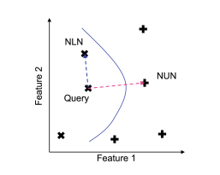
NEAREST-UNLIKE NEIGHBOUR (NUN)
The CBR approach to counterfactual discovery uses similarities to Nearest-unlike Neighbours (NUN). The NUN is a data point that is similar to the query instance in terms of features but belongs to a different class.
N is the function that finds the query’s NUN.
x is the query and y is it’s class labal. x^{i} is the instances in the dataset X and y^{i} is the class label for x^{i}.
d is the distance which measures the similarity between query x and each instance in X, x^{i}.
N identifies the instance, x^{i}, that is most similar to the query, x, but with a different class label.
NUN is similar to the query x in terms of features, but belongs to a different class label. Hence y^{i} ≠ y.

Slide 6
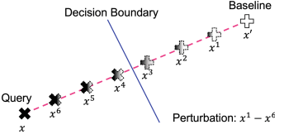
INTEGRATED GRADIENTS (IntG) FOR DisCERN
Gradient based approach to find the feature attribution weigths. The importance of a feature (attribution) is the sum of gradients on data points on a straight line from a baseline x’ and to the query x.
A is the number of perbutations (synthetic instances generated between x’ and x) and α is the number of integral interval steps. The amount of perturbation is controlled by the integral step α /A and the difference between the query, and the baseline (x – x’).
It is important that the baseline is close to the decision boundary because the goal is to find counterfactuals with minimal changes to cross the decision boundary. In DisCERN the NUN is choosen as the baseline.

Slide 7
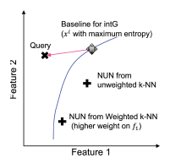
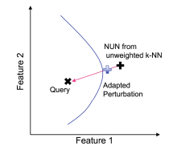
Bringing the nun closer
Although the NUN is a valid counterfactual, there could be an alternative that is closer to the query. An even closer NUN can be found by focusing on a subset of important features.
Weighted k-nn retrival
Adapted perturbations
Uses a feature attribution technique to assign weights to each feature.
Features with high weights are considered more important in the distance calculations.
If w1 > w2, N will return the NUN which is closer to the query x with respect to the feature 1.
The goal is to create a synthetic data point that is closer to the query than the NUN, while still beeing different enough to have a different class label.
Creates a syntetic instance by creating a perturbed instance between the NUN and the query x (blue cross). This new NUN is better because it is closer to the decision boundary (blue line), This point is closer in feature space to the query x.

Slide 8
Experiment setup
Split dataset in train and test.
Use a black-box classifier to create a case-base of labelled training data.
From the test set, instances classified into the least desirabel class becomes the queries to generate counterfactual explanations. This is refered to as the Negative test set.
DisCERN uses the classifier and the case-base to find counterfactual explanations for all queries in the Nagative test set.

Slide 9
evaluation
QUESTIONS
PERFORMANCE MEASURES
How does IntG compare to other feature attribution methods for counterfactial discovery with DisCERN?
How does DisCERN with IntG feature attributions compare against other counterfactual discovery algorithms in literature?
What is the impact of bringing NUN closer in NUN-based counterfactual discovery?
Validity: Measures the precentage for which the algorithm is able to find a counterfactual with the desired label.
Sparsity: The average of feature difference between the query and its counterfactual explanation.
Proximity: The mean feature-wise distance between a query and its counterfactual explanation.

Slide 10
result
COMPARISON WITH OTHER FEATURE ATTRIBUTION VARIANTES
Random
X²
LIME
SHAP
IntG with NUN baseline
IntG achive lowest sparsity (few changes in features) and Random achives lowest proximity (distance between x and $\hat{x}$).
Since IntG with NUN baseline has low sparsity, the number of adaption operations are reduced compared to the other variants.

Slide 11
result
COMPARISON OF COUNTERFACTUAL DISCOVERY ALGORITHMS
DiCE: A generative algorithm that discovers counterfactuals by optimizing a randomly initialized input.
NICE: A NUN-based counterfactual discovery algorithm that uses a reward function to minimize sparsity, proximity, and preserve plausibility.
DiCE is better for sparsity but at the expence of proximity (requires large value adaptions).
Comapring NiCE and DisCERN, DisCERN achives lower sparsity and proximity, which makes it more suitable for counterfactual discovery.

Slide 12
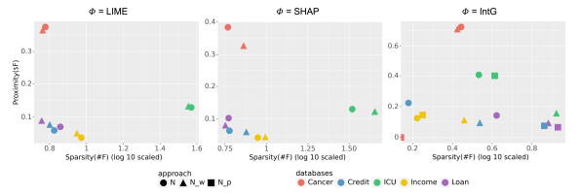
result
IMPACT OF BRINGING NUN CLOSER
Weighted kNN Retrieval (Nw): Uses feature attribution to select features for distance calculation.
Non-weighted kNN Retrieval (N): Uses the NUN without considering the feature weights.
Adapted Perturbation (Np): Create a syntetic perturbed NUN closer to the query.
Np with IntG and Nw with SHAP and IntG showed increased sparsity and decreased proximity compared to N.

